Slide 1
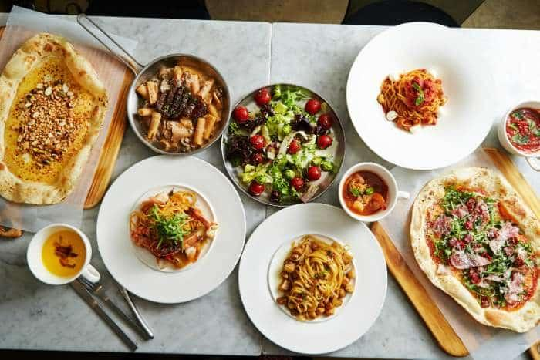
Identifying and Recommending Best Restaurants
There are many requirements from the customer side where the customer wants to decide on restaurants based on the cuisines, whether the restaurant is delivering food or not, and previous customers’ ratings.

Slide 2
Problem statement
There are many restaurants spread geographically around this world. In this situation, customers cannot easily decide which restaurant is best.
There are many requirements from the customer side where the customer wants to decide on restaurants based on the cuisines, whether the restaurant is delivering food or not, and previous customers’ ratings.

Slide 3
TASK
The task was to develop a solution to fulfil customers’ requirements where customers can decide on restaurants based on the cuisines, whether the restaurant is delivering food or not, and previous customers’ ratings.
The solution predicts the best restaurant filtered by region or country.

Slide 4
Approach:
To Perform a preliminary data inspection
Explore the geographical distribution of the restaurants, finding out the cities with the maximum/minimum number of restaurants.
Explore how ratings are distributed overall.
Ratio between restaurants that allow table booking and those that do not?
Percentage of restaurants providing online delivery
The difference in no. of votes for the restaurants that deliver and the restaurant that don’t
The top 10 cuisines served across cities
1

Slide 5
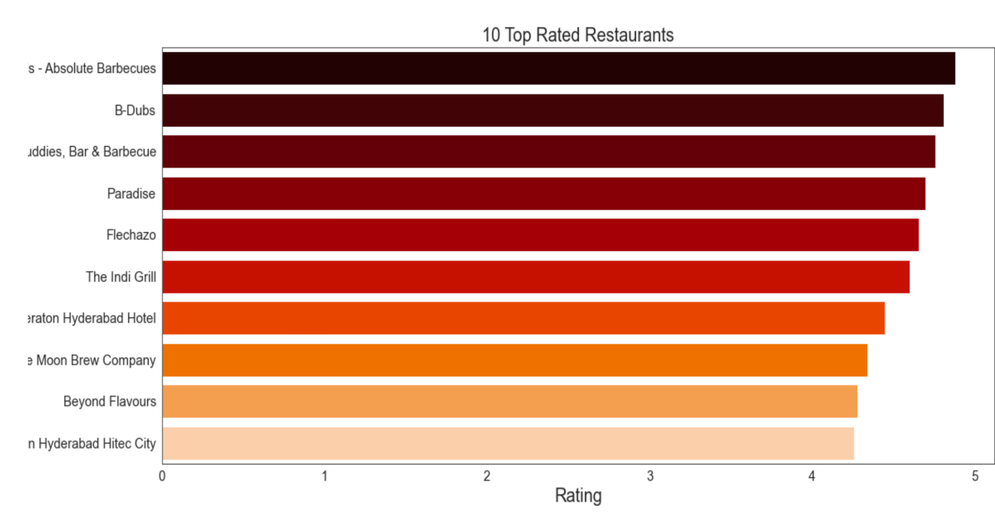
Top Rated Restaurants: The following are the 10 Top Rated Restaurants:

Slide 6
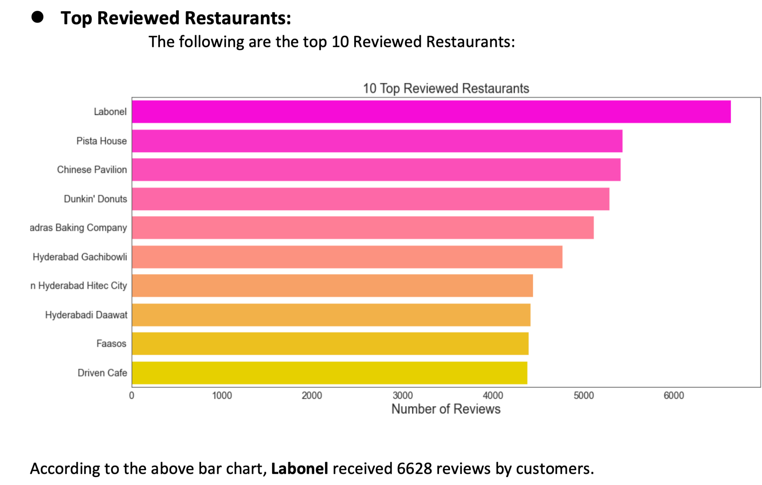

Slide 7
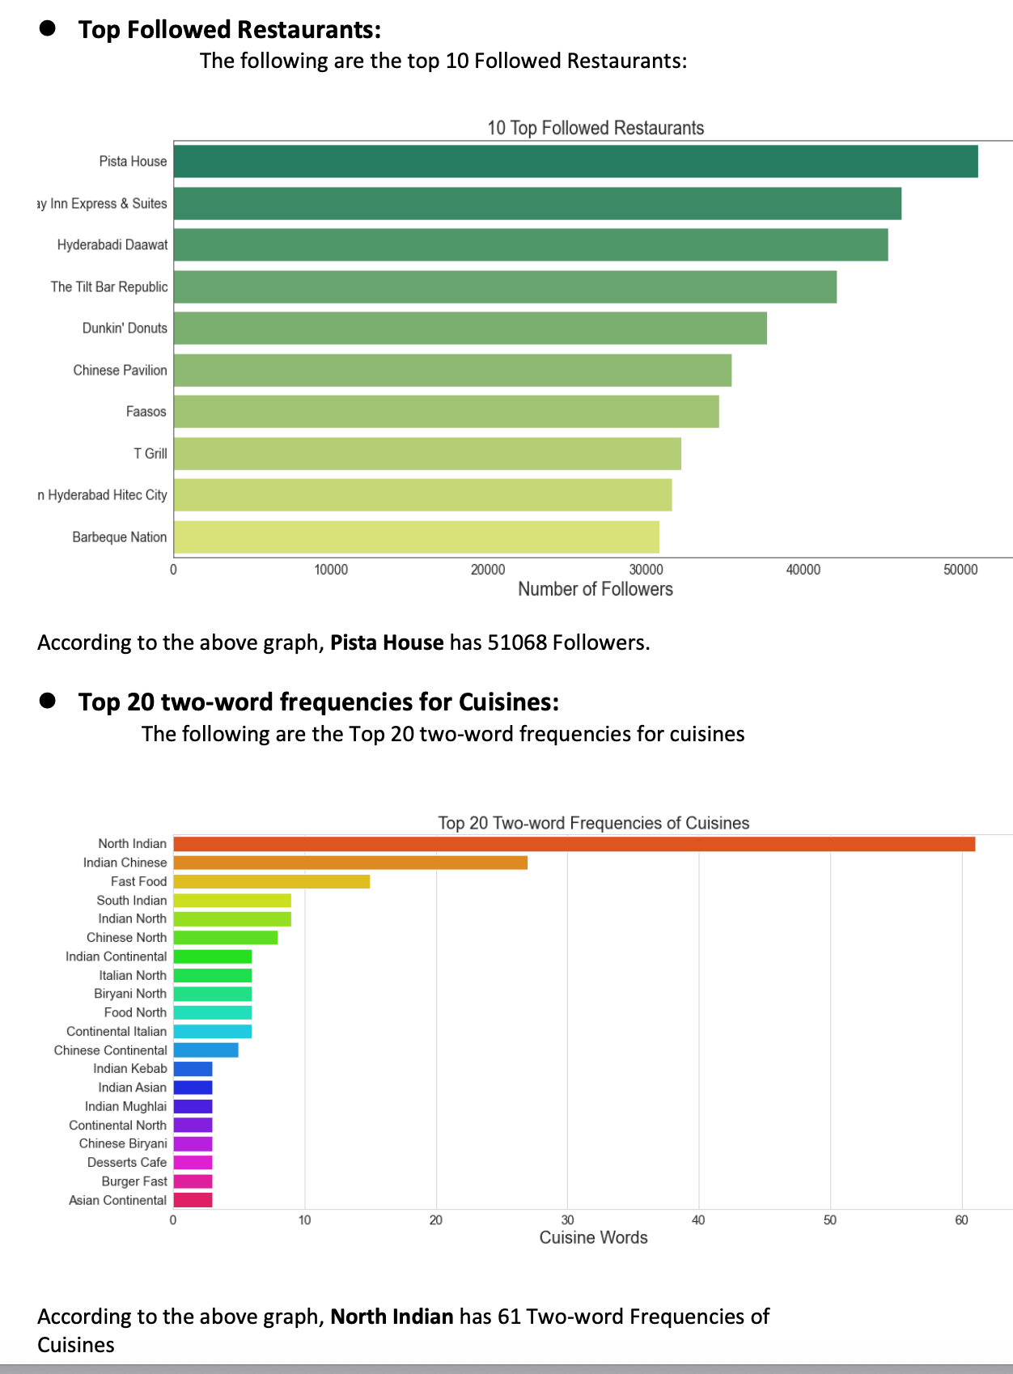

Slide 8
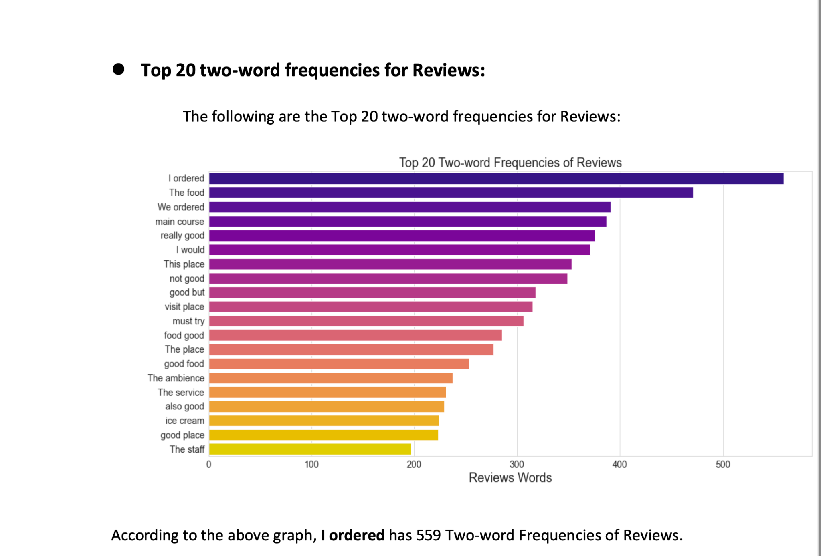

Slide 9
Conclusion:
Recommendations
Data Science helps us to achieve our target to made Restaurant Recommender System. As I have made the Restaurant Recommender System, the system suggested restaurants, cuisines and cost according to the customer input. The customers can see the suggestions and select the restaurants which are according to their taste and their budget. Customers can also pick nearby restaurants for faster delivery or purchasing. Thus Restaurant Recommender System can give competitive advantage to the company and their fame will be increased by this unique idea.

Slide 10
Questions?

